Slide 1
ECE 4115
Control Systems Lab 1
Spring 2005
Chapter 1
System models

Slide 2
Control System Toolbox
4 basic types of LTI models
  Transfer Function (TF)
  Zero-pole-gain model (ZPK)
  State-Space models (SS)
  Frequency response data model (FRD)
Conversion between models
Model dynamics

Slide 3
Matlab
Start → Run → \\laser\apps
Open MatlabR14 and double click on MATLAB 7.0.1

Slide 4
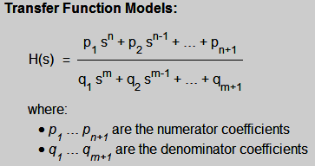
Transfer Function Models

Slide 5
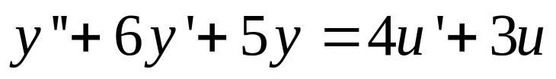
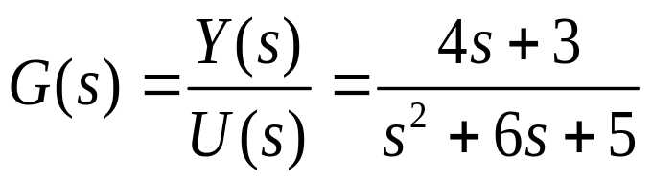
Transfer Function
Consider a Linear time invariant (LTI) single-input/single-output system
Applying Laplace Transform to both sides with zero initial conditions

Slide 6
Command tf
Command | Help
tf | Creation of transfer functions sys=tf(num,den) creates a continuous-time transfer function sys with numerator(s) num and denominator(s) den. The output sys is a tf object. For SISO models, num and den are row vectors listing, respectively, the numerator and denominator coefficients in descending powers of s by default.

Slide 7
Command tf
>> num = [4 3];
>> den = [1 6 5];
>> sys = tf(num,den)
  Transfer function:
  4 s + 3
  -----------------
  s^2 + 6 s + 5

Slide 8
Command tfdata
Command | Help
tfdata | Quick access to transfer function data. [num,den]=tfdata(sys,'v') returns the numerator and denominator as row vectors. If sys is not a transfer function, it is first converted.

Slide 9
Command tfdata
>> [num,den] = tfdata(sys,'v')
num =
0 4 3
den =
1 6 5

Slide 10
My first program: Chp1_1.m
  %Program to write a Transfer function
  %Author: Firstname Lastname
  clear all
  close all
  clc
  num = [4 3];
  den = [1 6 5];
  sys = tf(num,den) %transfer function model
  [num1,den1] = tfdata(sys,'v')
Notes:
Open File → New → M-File
Save File as H:\ECE4115\Module1\Mod1_1.m

Slide 11
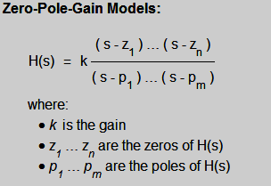
Zero-pole-gain models

Slide 12
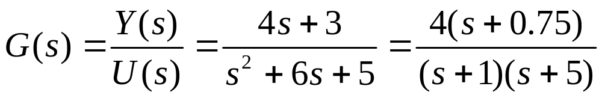
Zero-pole-gain model (ZPK)
Consider a Linear time invariant (LTI) single-input/single-output system
Applying Laplace Transform to both sides with zero initial conditions

Slide 13
Command zpk
Command | Help
zpk | Create zero-pole-gain models sys=zpk(z,p,k) creates a continuous-time zero-pole-gain model sys with zeros z, poles p, and gains k. The output sys is a zpk object. For SISO models, z and p are the vectors of zeros and poles (set Z=[ ] if no zeros) and K is the scalar gain.

Slide 14
Command zpk
>> sys1 = zpk(-0.75,[-1 -5],4)
Zero/pole/gain:
4 (s+0.75)
-----------
(s+1) (s+5)

Slide 15
Command zpkdata
Command | Help
zpkdata | Quick access to zero-pole-gain data. [z,p,k]=zpkdata(sys,'v') returns the zeros z and poles p as column vectors and the gain k of the system. If sys is not in zero-pole-gain format, it is first converted.

Slide 16
Command zpkdata
>> [ze,po,k]=zpkdata(sys1,'v')
ze =
-0.7500
po =
-1
-5
k =
4

Slide 17
H:\ECE4115\Chp1\Chp1_2.m
%Program to write a Zero-Pole-Gain Model
%Author: Firstname Lastname
clear all
close all
clc
z= -0.75;
p = [-1 -5];
g = 4;
sys1 = zpk(z,p,g)
disp('The zeros, poles and gain corresponding to the system are')
[ze,po,k]=zpkdata(sys1,'v')

Slide 18
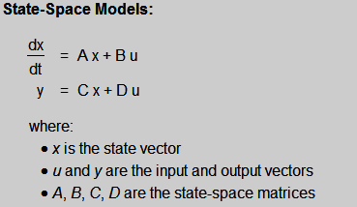
State-space Models

Slide 19
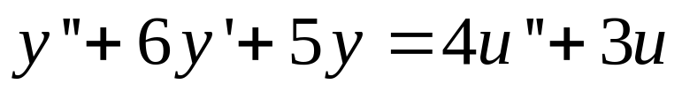
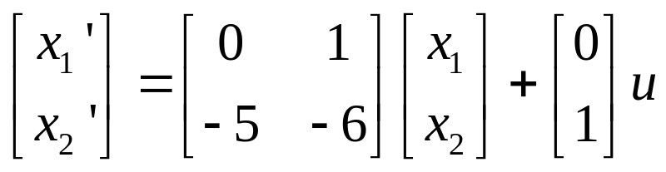
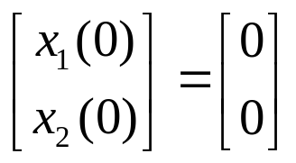
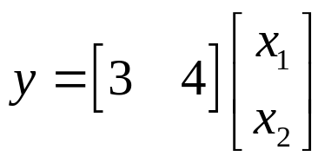
State-space Models
Consider a Linear time invariant (LTI) single-input/single-output system
State-space model for this system is

Slide 20
Command SS
>> sys = ss([0 1; -5 -6],[0;1],[3,4],0)
a =
x1 x2
x1 0 1
x2 -5 -6
b =
u1
x1 0
x2 1
c =
x1 x2
y1 3 4
d =
u1
y1 0
Continuous-time model.

Slide 21
Command ssdata
>> [A, B,C,D] = ssdata(sys)
A =
0 1
-5 -6
B =
0
1
C =
3 4
D =
0

Slide 22
H:\ECE4115\Chp1\Chp1_3.m
%Program to write a State-space Model
%Author: Firstname Lastname
clear all
close all
clc
A = [0 1; -5 -6];
B = [0; 1];
C = [3 4];
D = 0;
sys = ss(A,B,C,D)
[A,B,C,D] = ssdata(sys)

Slide 23
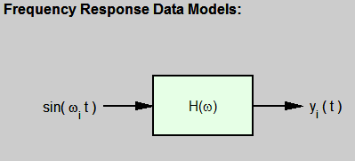
Frequency Response Data Models

Slide 24
Frequency Response Data Models
freq = [1000; 2000; 3000];
resp = [1;2;3];
H = frd(resp,freq)
From input 1 to:
Frequency(rad/s) output 1
---------------- --------
1000 1
2000 2
3000 3
Continuous-time frequency response data model.

Slide 25
Conversion between different models
sys_tf = tf(sys) converts an arbitrary LTI model sys to equivalent transfer function representation
sys_zpk = zpk(sys) converts an arbitrary LTI model sys to equivalent transfer function representation
sys_ss = ss(sys) converts an arbitrary LTI model sys to equivalent transfer function representation

Slide 26
Model Dynamics
pzmap: Pole-zero map of LTI models.
pole: computes the poles of LTI models.
eig: computes the poles of LTI models.
zeros: computes the zeros of LTI models.
dcgain: DC gain of LTI models.

Slide 27
Pzmap
Command | Help
pzmap | Pole-zero map of LTI models. pzmap(sys) computes the poles and (transmission) zeros of the LTI model sys (which can be either a tf, ss or zpk) and plots them in the complex plane. The poles are plotted as x's and the zeros are plotted as o's. [p,z]=pzmap(sys) returns the poles and zeros of the system in two column vectors p and z. No plot is drawn on the screen.

Slide 28
Poles and Eigen Values
Command | Help
pole | Compute the poles of LTI models. p=pole(sys) computes the poles p of the LTI model sys (which can be either a tf, ss or zpk). The output p is a column vector.
eig | Compute the poles of LTI models p=eig(sys) computes the poles p of the LTI model sys (which can be either a tf, ss or zpk). The output p is a column vector.

Slide 29
Zeros
Command | Help
zero | Compute the zeros of LTI models. z=zero(sys) returns the transmission zeros of the LTI model sys. [z,gain]=zero(sys) also returns the transfer function gain (in the zero-pole-gain sense) for SISO models sys.

Slide 30
Dcgain
Command | Help
dcgain | DC gain of LTI models. k=dcgain(sys) computes the steady-state (D.C. or low frequency, i.e. G(0)) gain of the LTI model sys.

Slide 31
H:\ECE4115\Chp1\Chp1_3.m
%Program to write a State-space Model and understand model dynamics
%Author: Firstname Lastname
clear all
close all
clc
num = [4 3];
den = [1 6 5];
sys = tf(num,den) %sys in transfer function model
sys_ss = ss(sys) %sys_ss in state space model
pzmap(sys) %plot pole-zero map
p = pole(sys) %determine poles
po = eig(sys) %determine poles
z= zero(sys) %determine zeros
k= dcgain(sys) %determine DC gain

Slide 32
HW #1
One submission per team
Submit HW1_1.m, HW1_2.m and Hw1_3.m

Slide 33
Questions???
Next Class on Mar 4th

